Slide 1
Te Reo Introductory Rite 1/2
Introductory Rite
Priest: Ki te ingoa o te Matua,
In the name of the Father
o te Tamaiti,
of the Son
o te Wairua Tapu.
of the Holy Spirit.
People: Āmene
Amen

Slide 2
Te Reo Introductory Rite 2/2
Priest: Kia noho te Ariki ki a koutou.
The Lord be with you
People: Ki tōu wairua anō hoki.
And with your spirit

Slide 3
Response after the 1^{st&} 2nd reading
Proclaimer: Ko te Kupu a te Ariki
(The Word of the Lord)
All: Whakamoemiti ki te Atua
(Thanks be to God)
Notes:
3

Slide 4
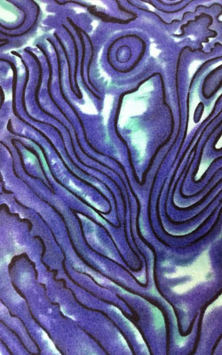
Response after 1st & 2nd Reading with background
Proclaimer: Ko te Kupu a te Ariki
(The Word of the Lord)
All: Whakamoemiti ki te Atua
(Thanks be to God)

Slide 5
Te Aroha with background
Te Aroha,
Te Whakapono.
Me te Rangimārie,
Tātou, tātou e.
Love
Faith and Peace
be with us all
Te Aroha © 1983, Morvin Simon, Whanganui

Slide 6
Te Reo Concluding Rite 1/2
Concluding Rite
Priest: Kia noho te Ariki ki a koutou.
The Lord be with you
People: Ki tōu wairua anō hoki.
And with your spirit
Priest: Kia whakapaingia koutou
e te Atua kaha rawa,
May Almighty God bless you,

Slide 7
Te Reo Concluding Rite 2/2
Priest: e te Matua, e te Tamaiti
the Father and the Son
e te Wairua Tapu.
and the Holy Spirit
People: Āmene
Amen
Priest: Haere koutou i runga i te rangimārie Go in peace.
People: Whakamoemiti ki te Atua
Thanks be to God

