Slide 1




Slide 2
Every day we witness the
testimony of courage and sacrifice
of healthcare workers.
Pope Francis: Message for International Nurses Day 2020

Slide 3
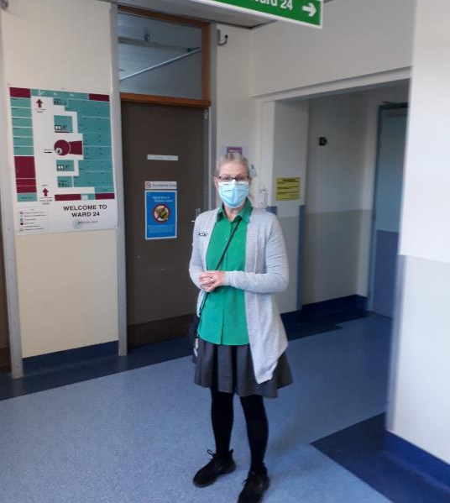
Kathleen Field
Hospital Chaplain
Life is fragile. Empathising and being present is what we can offer to enable people to work out their own answers to life’s big questions.

Slide 4
There are only two kinds of people:
those who care for someone who is hurting and those who pass by.
Pope Francis: Fratelli Tutti 2020

Slide 5
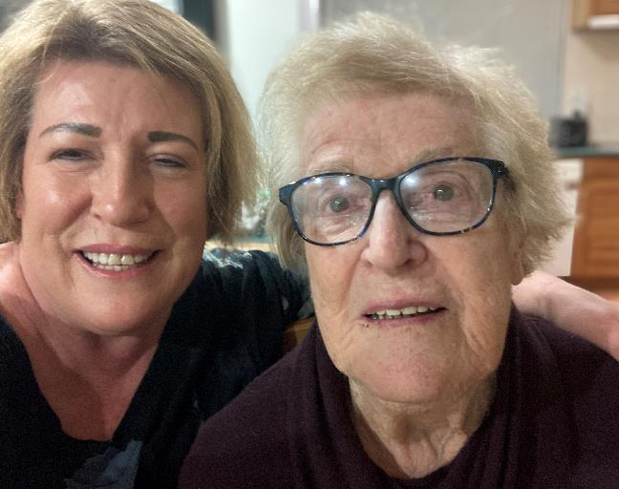
Jude McKee
Family carer
It’s about respecting everything that Mum’s ever done for me. Here she is, this beautiful lady who brought me into the world, and now it’s my turn.

Slide 6
Commendable is the effort of so many people who have been offering evidence of human and Christian love for neighbour, dedicating themselves to the sick even at the risk of their own health.
Pope Francis: General Audience: Healing the World – Faith and Human Dignity, 2020

Slide 7
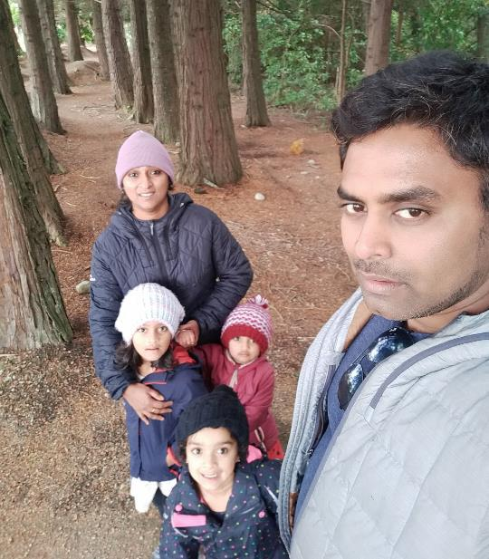
Bijo John
Nurse
Being a young father, thinking about what’s going to happen if I get Covid? But I took this career to take care of people. Whatever I can do, I do.

Slide 8
The pandemic has highlighted
how vulnerable and interconnected everyone is. If we do not take care of
one another, starting with the least,
we cannot heal the world.
Pope Francis: General Audience: Healing the World – Faith and Human Dignity, 2020

Slide 9
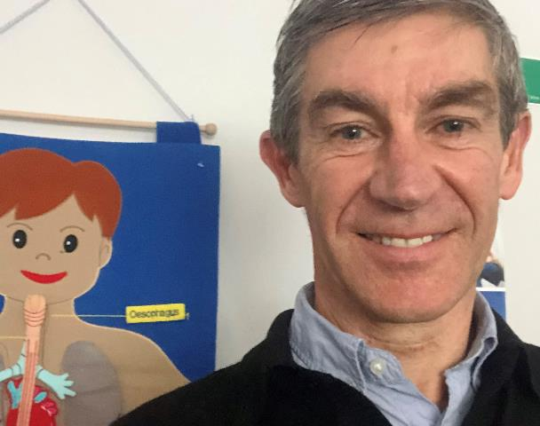
Bernard Leuthart
General Practitioner
We need to think about the silent ones, the ones who are vulnerable. Often it’s the poor who are silent.

Slide 10
The Good Samaritan parable shows us how a community can be rebuilt by men and women who identify with the vulnerability of others.
Pope Francis: Fratelli Tutti, 2020

Slide 11
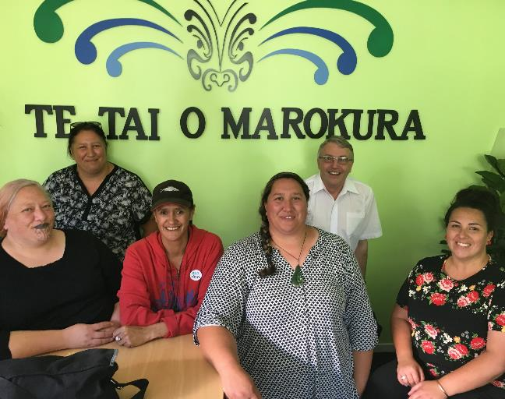
Hariata Kahu
Alcohol & Drug Counsellor
Everybody has a whakapapa. It’s always about wanting that sense of belonging and connection.

Slide 12
We must act now, to heal the epidemics caused by small, invisible viruses, and to heal those caused by the great and visible social injustices.
Pope Francis: General Audience, Healing the World – The preferential option for the poor, 2020

Slide 13
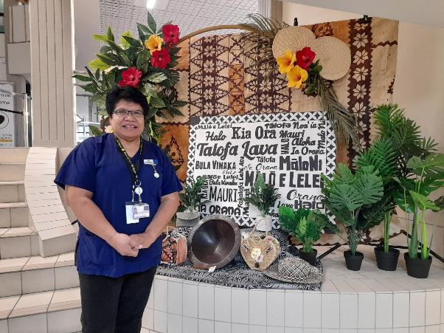
Sr Lusini Falemaka
Nurse
We need to give the right health information at the level and in the language that the people understand.

Slide 14
In these months, when the whole world was prey to a virus that brought pain and death, despair and bewilderment, how many outstretched hands have we seen!
Pope Francis: Message for the World Day of the Poor 2020

Slide 15
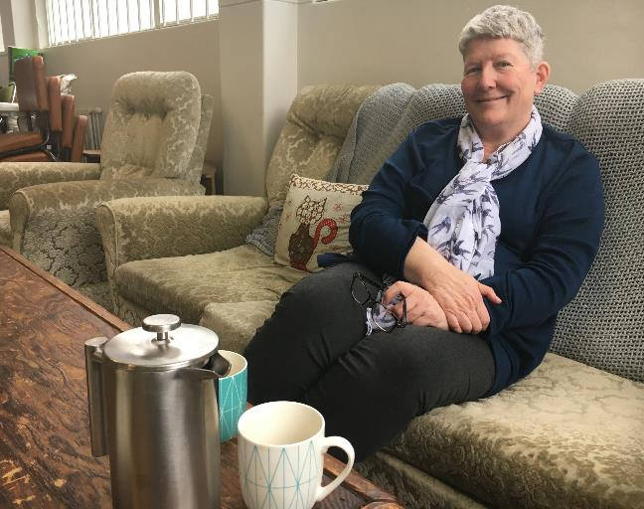
Wendy Hill
Supporter of
Pregnant Women
If someone needs a listening ear, I’m here.

Slide 16
Before the needs of our brothers and sisters, Jesus asks us to stop and listen, to establish a direct and personal relationship with others.
Pope Francis: Message for the World Day of the Sick, 2021

Slide 17
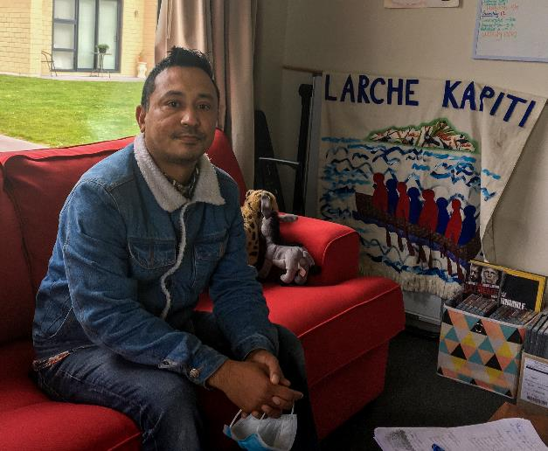
Aye Maung
L’Arche house leader
We are all humans with our physical, spiritual and emotional needs, and all our needs have to be met in the most dignified way.

Slide 18
Protect the doctors, nurses, healthcare personnel and volunteers who in this time of emergency are on the front lines and put their lives at risk to save other lives. Accompany their heroic efforts and give them strength, goodness and health.
Pope Francis: Prayer of the Rosary to put an end to the pandemic, 2021

Slide 19


Slide 20


