Slide 1
The Stations of the Cross
From the parish of
St Anne’s Catholic church
Newtown, Wellington.
2013

Slide 2
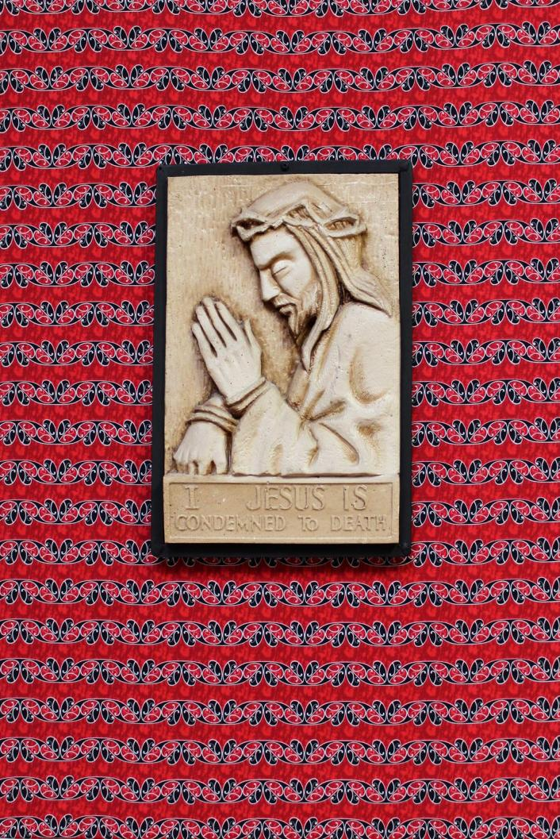
I
Jesus is condemned to death.
Ka whakawātia a Hehu kia mate.
(Maori)
Notes:
The dominant pattern on this material is the silver fern or koru representing life, growth and harmony. The colour red is often used in Māori designs, because it is believed that when Papatuanuku (earth) and Ranginui (heaven) separated there was much blood shed which is represented by the colour red. The material links to the carving in the chapel which relates to the creation, which reminds us that God is present in all cultures.

Slide 3
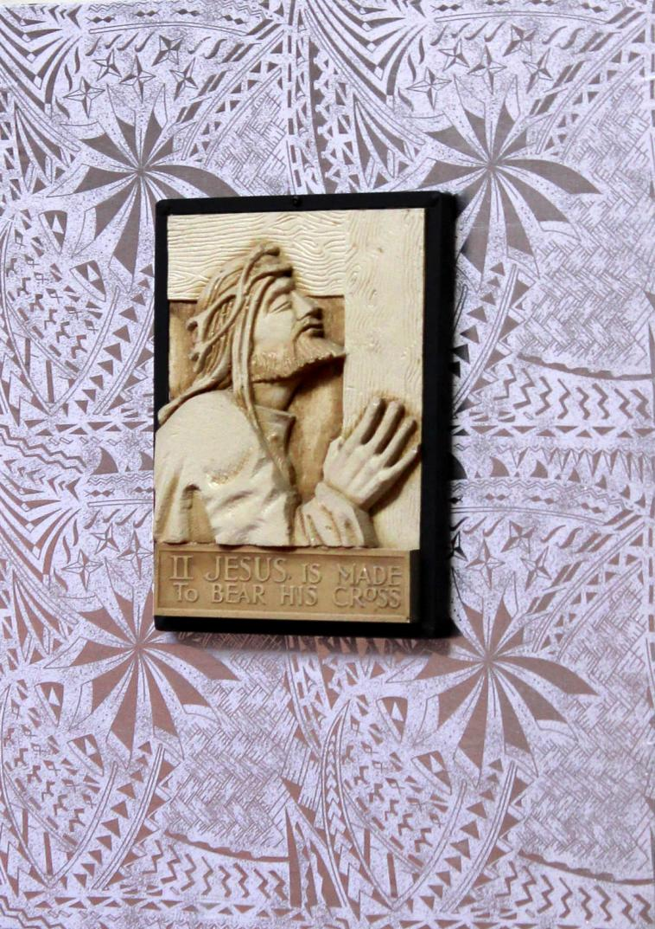
II
Jesus is made to bear His cross.
Iesu ua tauave lona
Koluse.
(Samoa)
Notes:
We chose this fabric, as a reminder that our culture and traditions are a way of glorifying God in our everyday lives.
White Fabric (ie pa’epa’e) – ose fa’ailoga lea ole loto mama, fa’amaoni, loto alofa, loto fa’amagalo. It is a symbol of purity of heart, charity, humility and forgiveness (virtues to promote in everyday living).
Five Stars (fetu e lima)– adopted from the Samoan flag – fa’ailoga o le fu’a o le sa’olotoga ma le talitonuga “e fa’avae i le Atua Samoa.” They are a symbol of the Samoan spirit of independence and freedom and a belief that “Samoa is founded on God”.
Fine mat (ie toga) – ole measina ale atunu’u e fa’aaogaina lea mo se ifoga mole fa’amagalona ose sese ma e fa’aaogaina e momoli atu ai le taulaga fa’afetai ile Atua. The weaving of the mat design in the background symbolises both a time of asking for forgiveness (as seen during the penitential rite) and/or an offering of our most treasured possession (as seen during offertory).
Samoan Patterns – fa’ailoga o Samoa o le atunu’u tofi, ma tofia e le Atua Samoa e pulea e matai. Patterns symbolise that Samoa is a nation with a culture and traditions, gifted from God, based on a matai system where a titled name is bestowed on a leader (servant leadership) of a family and a village.

Slide 4
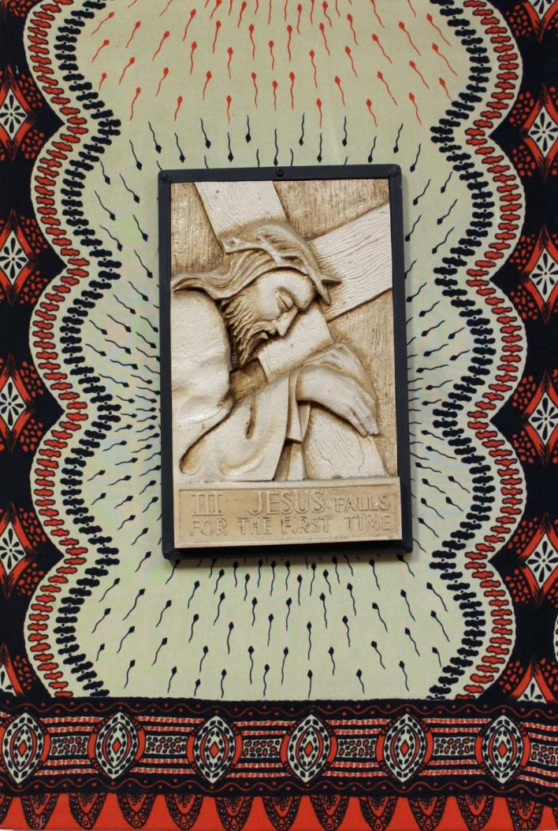
III
Jesus falls for the first time.
Yezu aguye numusaraba ubwambere.
(Rwanda)
Notes:
The material chosen for the third station of the cross is of African design. The artisan, when she meditates at this station, gives thanks to God that she has been rescued from the Rwandan genocide and now lives peacefully in New Zealand. She prays that one day her daughter and grandchildren will have the same opportunity and experience of peace as she has. She prays they will enjoy being united with their mother, brother, and nephews in Wellington.

Slide 5
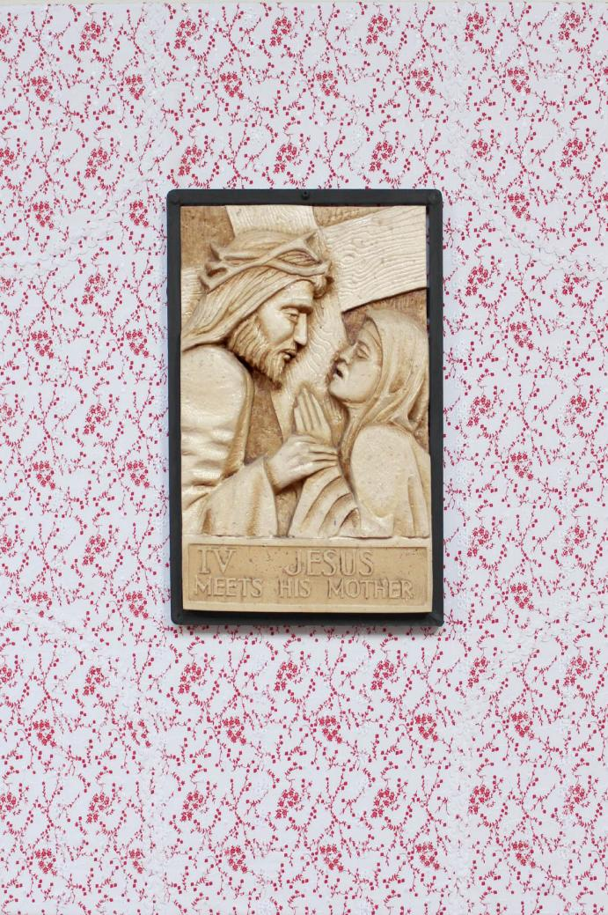
IV
Jesus meets His mother.
Jezu aple avoik mellta. (Goa)
Notes:
The saddo, which is plain or printed with a red background, is a significant dress. It is even more important than the wedding gown. The shopkeeper while handing over the fabric to the yesman or any female relative of the groom, says “Borem borem zaun okle noureachem,” in other words. (may the couple be happy)
The saddo is important because it is with that dress that the bride begins her married life at her husband’s house. When the bride comes into the house for the first time on the day of the wedding, the saddo is placed on her shoulders and the ceremony is accompanied by the zotis.
By placing the saddo on the young woman’s shoulder, female relatives hand her over to the young man’s family and they welcome the young woman as their daughter-in-law.
On the day the saddo fabric is to be cut, relatives and neighbours are invited to witness the ceremony. The tailor uses strips of white cloth or alternatively uses cotton tape to make a cross and cuts the fabric. A statuette of Mother Mary is placed on a plate on the table. Blessings of Our Lady are invoked on the saddo and those present place some money in the plate, which is then shared by the tailor and his assistant. Firecrackers burst to announce the cutting of the saddo. The tailor will later stitch the main wedding dress or gown in a milky white colour.

Slide 6
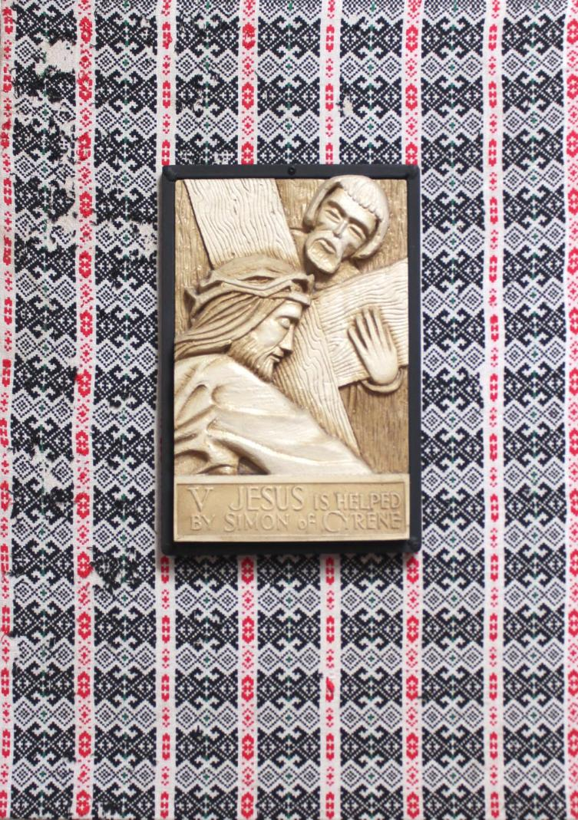
V
Jesus is helped by Simon of Cyrene.
Šimun Cirenac pomaže Isusu nositi križ.
(Croatia)
Notes:
Fabric from Croatia was donated by the Barbalich family. This fabric was part of the décor when Vlado Barbalich began a regular gathering of mostly Croatian people and their families called ‘Paidasi’ (party with friends). Paidisis became a big part of our family life as about 30-40 people would attend on a six weekly basis at our home. The evening was filled with Croatian music. Eating, then singing and dancing continued until the early hours. The men would prepare a delicious Croatian sausage called cevapcici. It consisted of minced lamb, pork and veal flavoured with garlic, onion and parsley and olive oil and barbequed over charcoal in a 40 gallon drum. This food was accompanied with a variety of salads, bread and wine. It was lovely and warm round the fire in winter.
These gatherings, continued for about 25 years, and we have countless memories during these festive times.

Slide 7
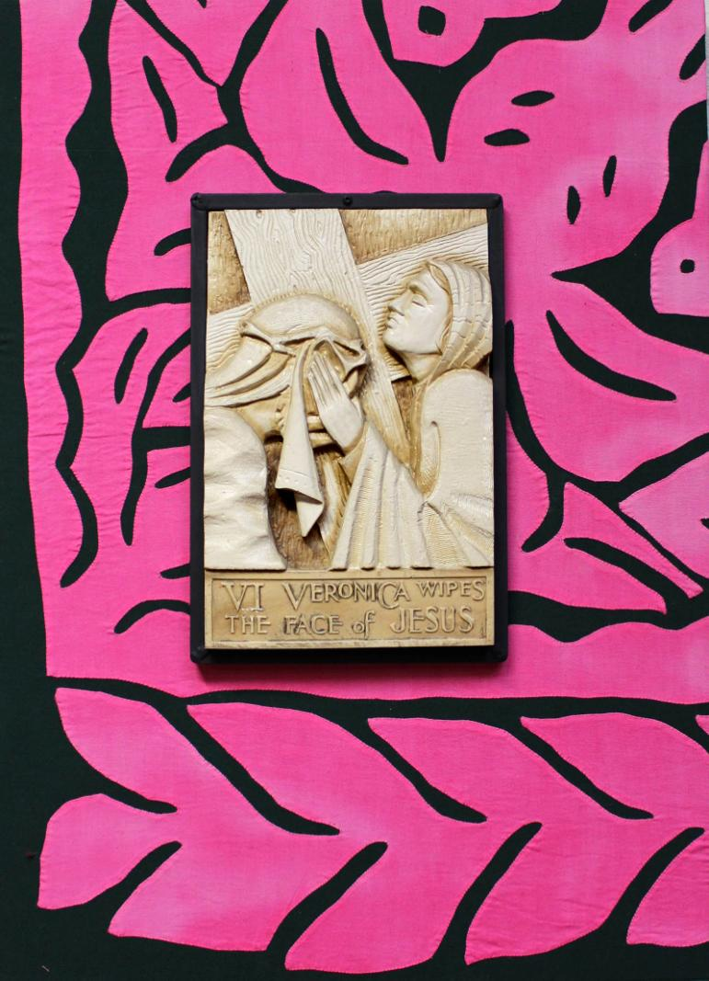
VI
Veronica wipes the face
of Jesus.
Veronika te ingoai te mata o Iesu Kirito.
(Cook Islands)
Notes:
The tiavaevae donated to the church was made by some women in Matavera village Rarotonga Cook Islands. The artisan explains, “the design symbolises the unity of family and the love of life, and the love of God in each and everyone. This tiavaevae is very precious to me as it was given to me by my cousin’s wife Bev Pierre and her husband Charlie Pierre, they live here, but he is from the village of Matavera. This work demonstrates the unity of family and the love I have for our family”.

Slide 8
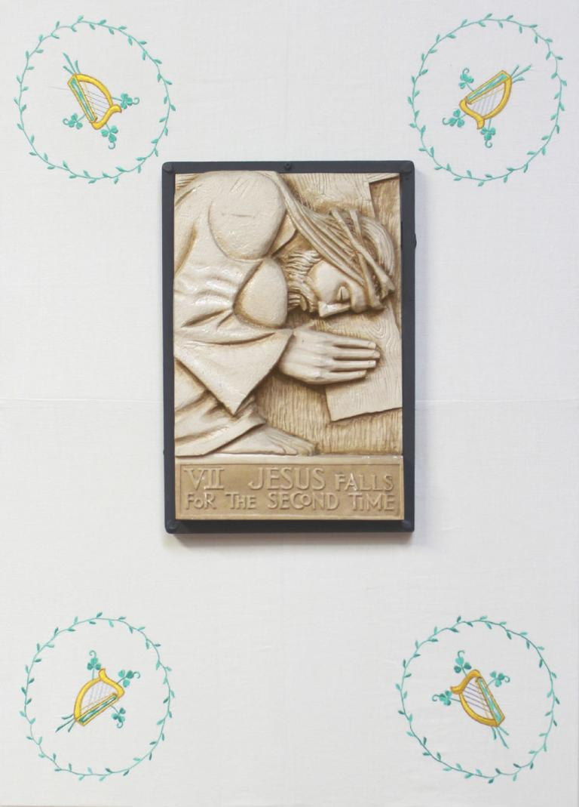
VII
Jesus falls for the second time.
Íosa falls ama don dara. (Ireland)
Notes:
The fabric is made from Irish Linen adorned with shamrocks and celtic harps. Linen is significant in the bible as Jesus was wrapped in linen when he was laid in the tomb for 3 days. The Irish harp became a symbol for the newly independent Ireland in 1922, which many of our Irish families will have supported. The shamrock also signifies the past, the present and the future. There is an Irish myth that St Patrick used the Shamrock leaf to represent the Trinity of Father, Son and Holy Spirit with the three leaves. The Irish community are important to the history of Newtown, for they are the people who brought the Catholic church to Wellington so that we could have a future in the faith and we remember and honour them for that. We are all members of our present community, and we are also important in forming the future of our communities.

Slide 9
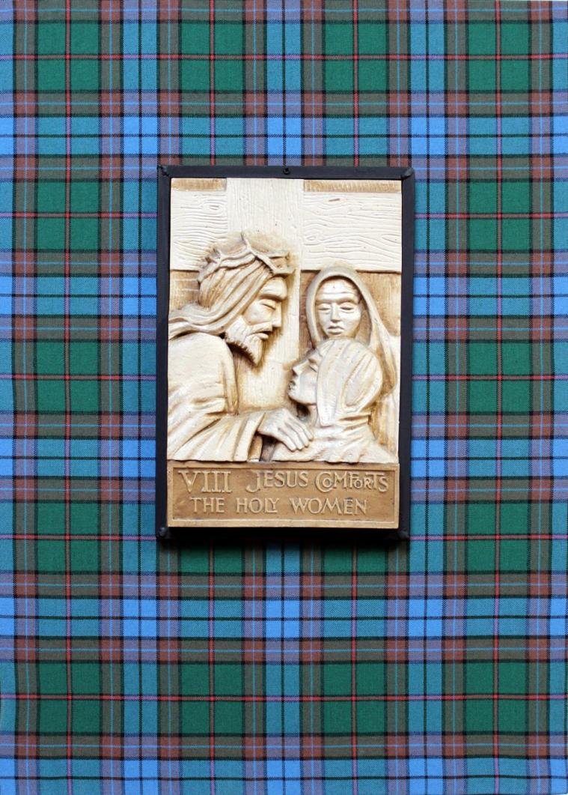
VIII
Jesus comforts the holy women.
Iosa a’toirt cofhurtachd do na mnathan noamh.
(Scotland)
Notes:
The New Zealand tartan is also known as the Piping and Dancing Association of New Zealand tartan. It was designed and launched at the New Zealand parliament on 26 February 2003. The colours reflect the those of this country of bush and sea, river and volcanoes.

Slide 10
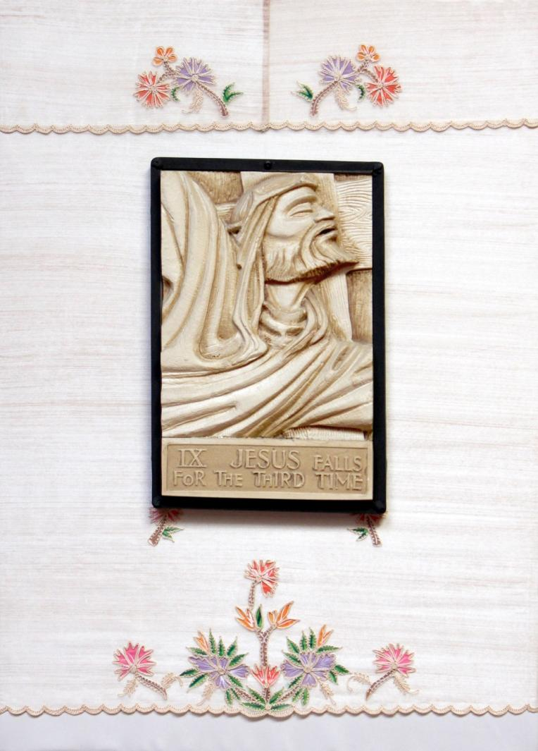
IX
Jesus falls for the third time.
Ang pangatlong pagkadapa ni Hesus. (Philippines)
Notes:
For Filipinos in the Philippines or overseas, our national costume is the Barong Tagalog (formal transparent shirt) for men and Maria Clara or Mestiza dress (long embroidered gown with either scarf or butterfly sleeves) for women. This material is part of a top and skirt meant for a special occasion that was brought from the Philippines. Materials used are pena (pineapple fibre) or jusi (banana fibre). These costumes symbolize our independence and love of country. The material used here is similar to pineapple fibre and is embroidered with coconut palms which are very common in our country and feature in our visual arts. Coconuts are vital for food as well as other uses like palms for roofs.

Slide 11
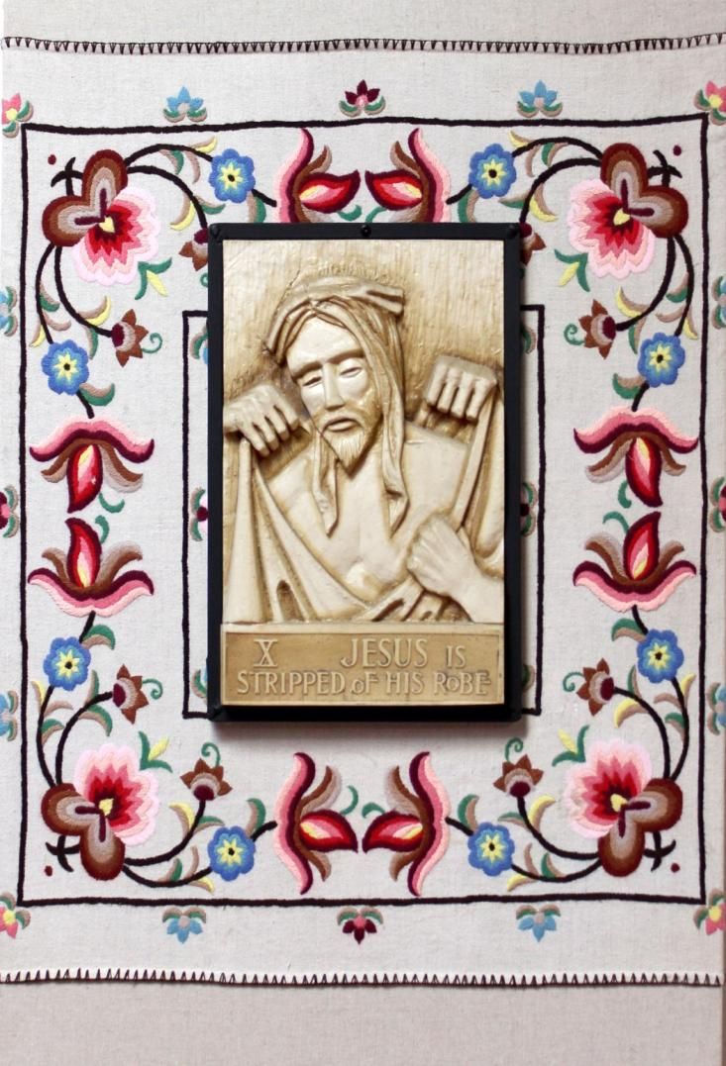
X
Jesus is stripped of His robe.
Jézust megfosztják a köpenyétöl
(Hungary)
Notes:
The Matyó embroidery is famous for its colorful, densely patterned designs predominantly decorated with red leaves and flowers. The most well-known, trademark-like Matyó pattern is the rose. The colors used in Matyo work symbolize elements of Hungarian life. Red represents joy, black of the earth, and blue of death and grief. The Matyó people are an ethnic group, who live in Mezőkövesd and its neighboring villages, Tard and Szentistván, in the North East part of Hungary. The name Matyó originates from the 15th century when King Matthias recognized Mezőkövesd as a 'Free Royal Town'.

Slide 12
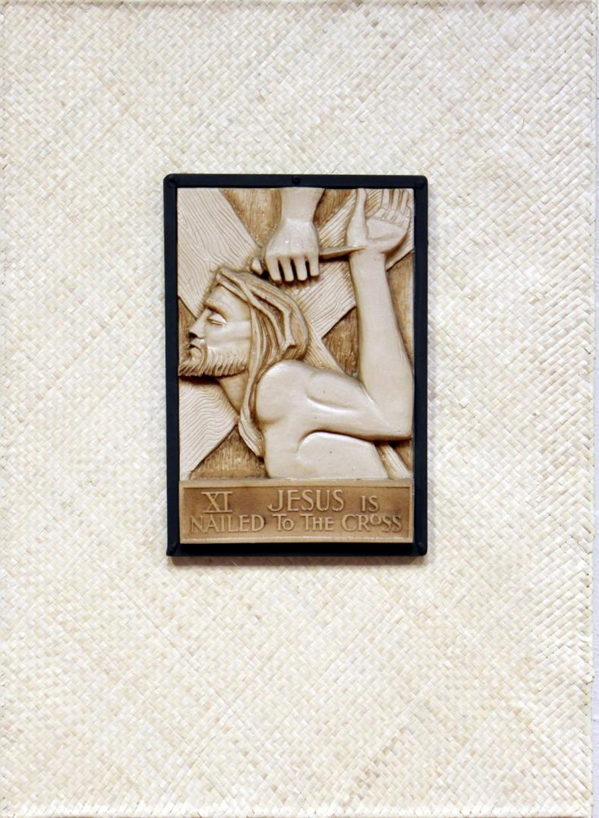
XI
Jesus is nailed to the cross.
Ko te tutukiga o Iehu ki te koluhe.
(Tokelau Islands)
Notes:
The fine mat covering the station of the cross was hand made especially by the women in the family of Fr Leone Iosefo, the priest in Sacramental Ministry for Wellington South Pastoral Area. Fine mats used in the church must be made from a special leaf called Lakei. The Lakei leaves are green in their natural state but by treating them in a special way they are bleached white. It is the whiteness of the mat that makes it worthy to be used inside a church. This station has become special to the community of St Anne’s because Fr Leone suffered a stroke recently and will not been able to return to ministry in the immediate future.

Slide 13
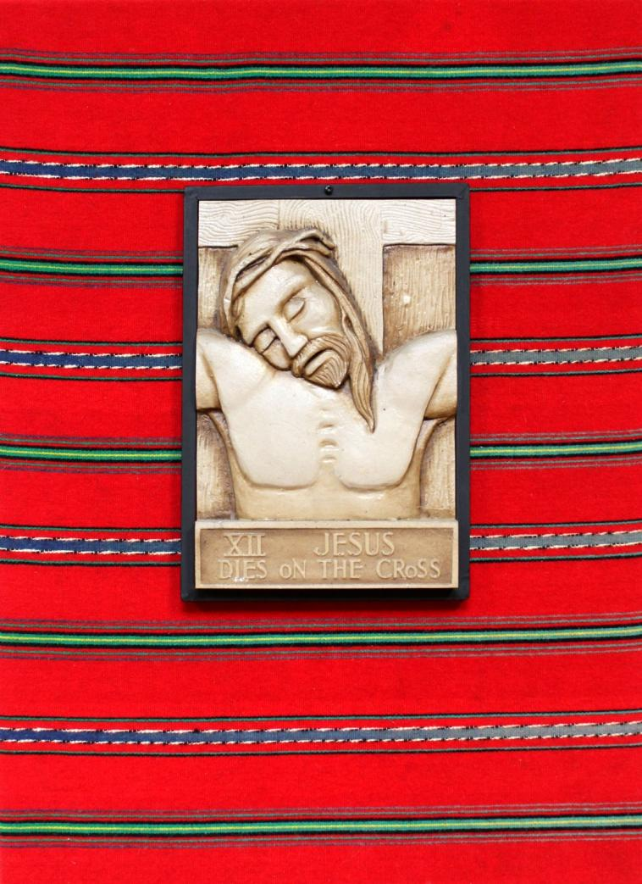
XII
Jesus dies on the cross.
Jezus umiera na krzyżu.
(Poland)
Notes:
Jezus umiera na krzyżu (Poland)
This fabric is known as Pasiaki Lowickie. Pasiaki means stripy fabric. It originated in Lowicz, Central Poland. The fabric was made of brightly coloured wool which was spun, dyed and woven at home. In the old days pasiaki were used as bedspreads, runners, furniture covers, warm winter skirts and even as wall hangings ­both as decorations and to make the room warmer in winter. Now, other articles are made of this fabric, such as bags and small decorative things, mostly for the tourist market.

Slide 14
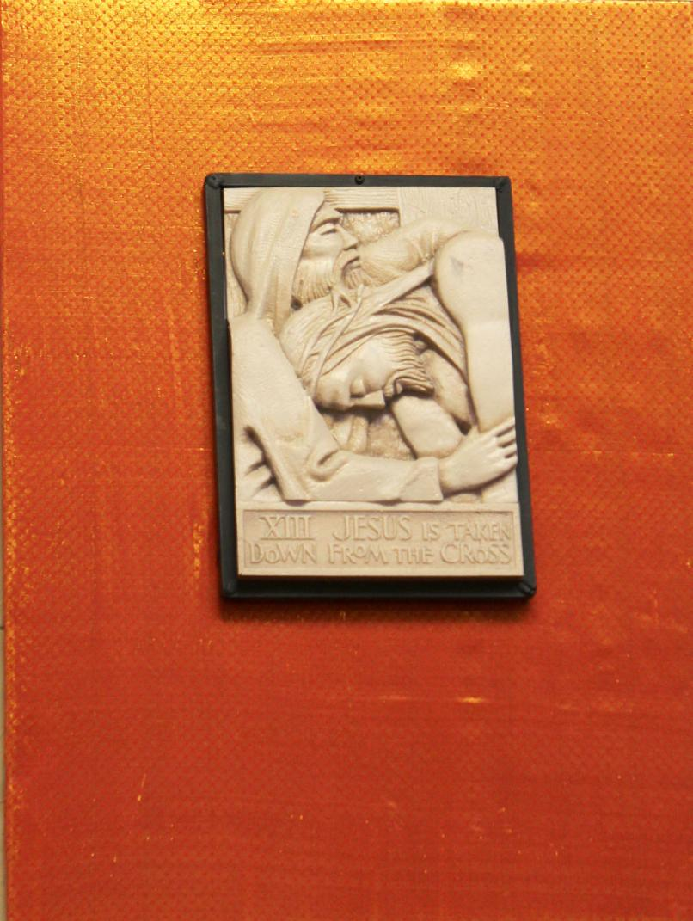
XIII
Jesus is taken down from the cross.
മിശിഹായുടെ മൃതദേഹം മാതാവിന്റെ മടിയില്‍ കിടത്തുന്നു
(Kerala)
Notes:
The fabric for the Kerala community was purchased especially for St Anne's Stations of the Cross by a member of the community travelling to New Zealand. The contributors were amazed when they saw which station of the cross the fabric was attached to. Their home church in Kerala has a very large statue of the Pieta, and the people there have a deep devotion to it. So when they saw that the Station was that of Mary holding her son, they felt that they truly belonged to the community at St Anne's, and that the connection with home was complete.

Slide 15
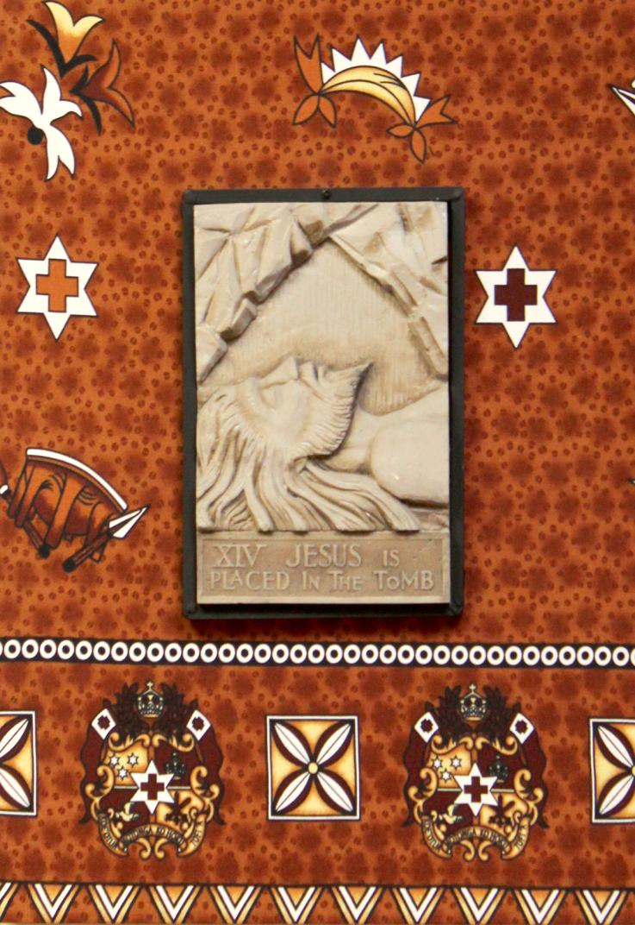
XIV
Jesus is placed in the tomb.
Ko e toka ‘a sesu ‘i he fonualoto.
(Tonga)
Notes:
The symbols on the station are based around the Tongan Coat of Arms, and the seal of the Tongan King. Images such as the Tanoa or kava Bowl are not unique to Tonga but play a significant role in community life. It is significant too that St Anne’s use a Kava bowl as a paten during our Sunday Masses.
The Coat of Arms has three stars and three swords all representing the three lines of Royal families in Tonga. There is also a dove carrying an olive branch, representing the hope of peace in their country.

Slide 16
Background
The Way of the Cross is walked by peoples of all cultures. The stories behind each of these images are a response from each ethnic group, to the invitation to contribute to the parish community, their unique voice.
The coordinator of the project who conceived of the idea to ‘reframe’ the existing stations, invited parishioners to locate and decorate the backing boards with fabric that had a particular meaning for them.
We have linked this story of the Stations of the Cross at St Anne’s to the Lenten theme for 2013 which features our partnerships in Oceania. The stories tell of many migrant groups settling in Aotearoa New Zealand. All have travelled here from across Te Moana-nui-a-Kiwa (the Pacific Ocean) to their new home.

Slide 17
Acknowledgements
We would like to thank everyone involved in this. In particular the parishioners of St Anne’s Catholic church Newtown. Also the following:
Karen Holland Lay Pastoral leader
Maria Rodgers Coordinator of the project
Liz Wootton Links to the Prayers for School Settings Lent 2013
Rev Leone Iosefo Sacramental ministry South Wellington
Emily Benefield Photography
Catherine Gibbs Caritas education coordinator
Nellie Stowers Caritas publiction assistant
Caritas Aotearoa New Zealand

