Slide 1
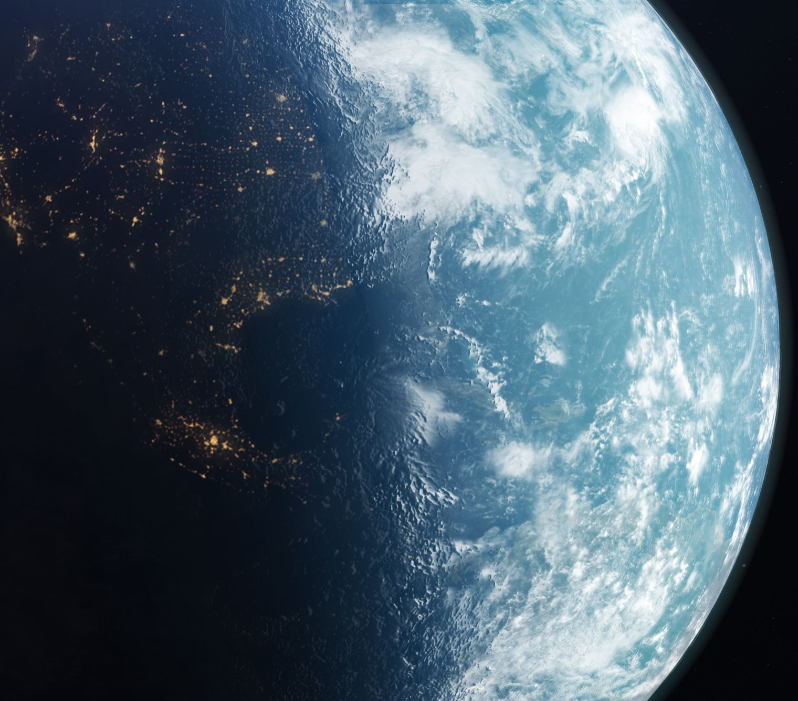
FOR THE BEAUTY OF THE EARTH
By John Rutter
Kings College Choir Cambridge

Slide 2
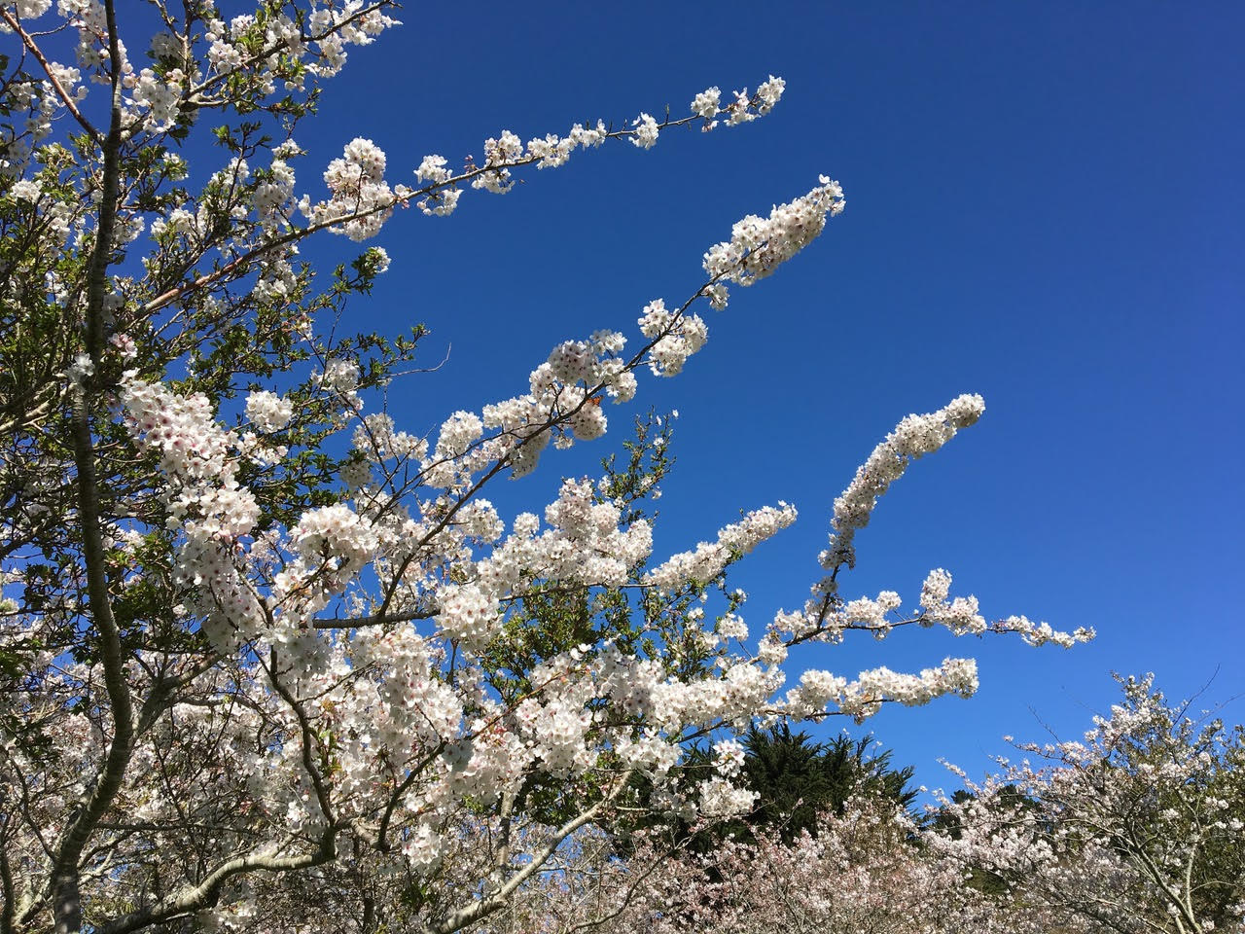
For the beauty of the earth For the beauty of the skies For the love Which from our birth Over and around us lies Over and around us lies
Lord of all to thee we raise This our joyful hymn of praise.

Slide 3
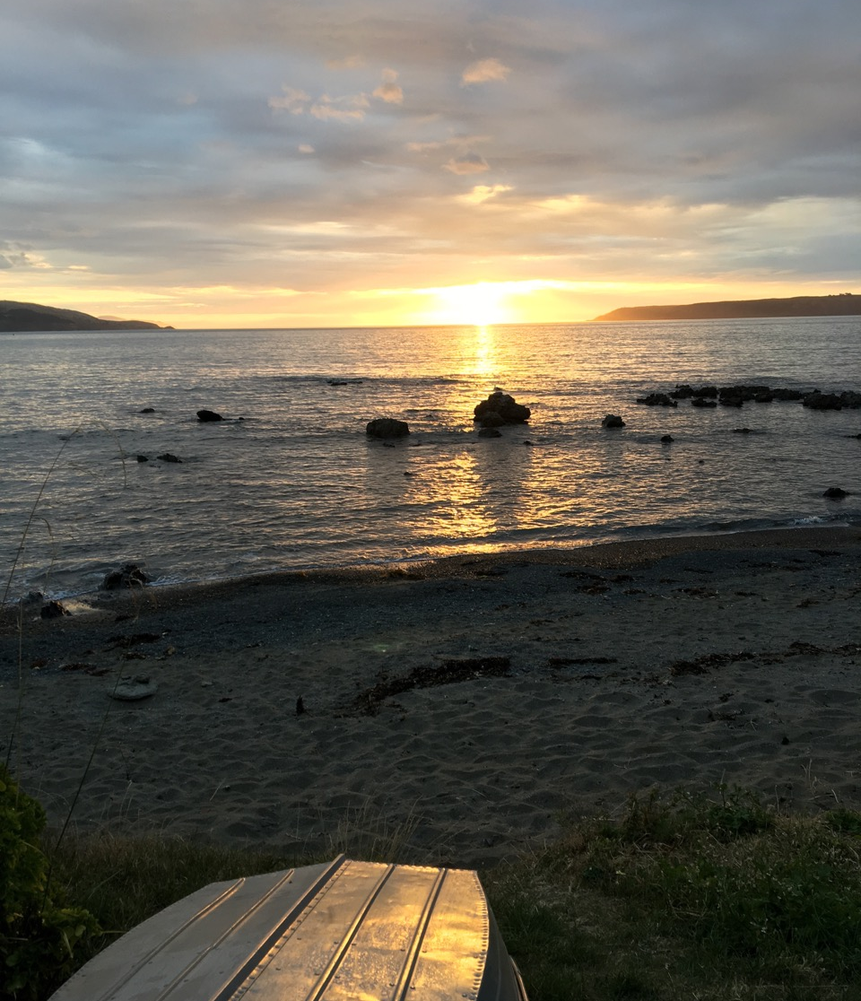
For the beauty of the hour Of the day and of the night Hill and vale And tree and flower Sun and moon and stars of light
Lord of all to thee we raise This our joyful hymn of praise.

Slide 4
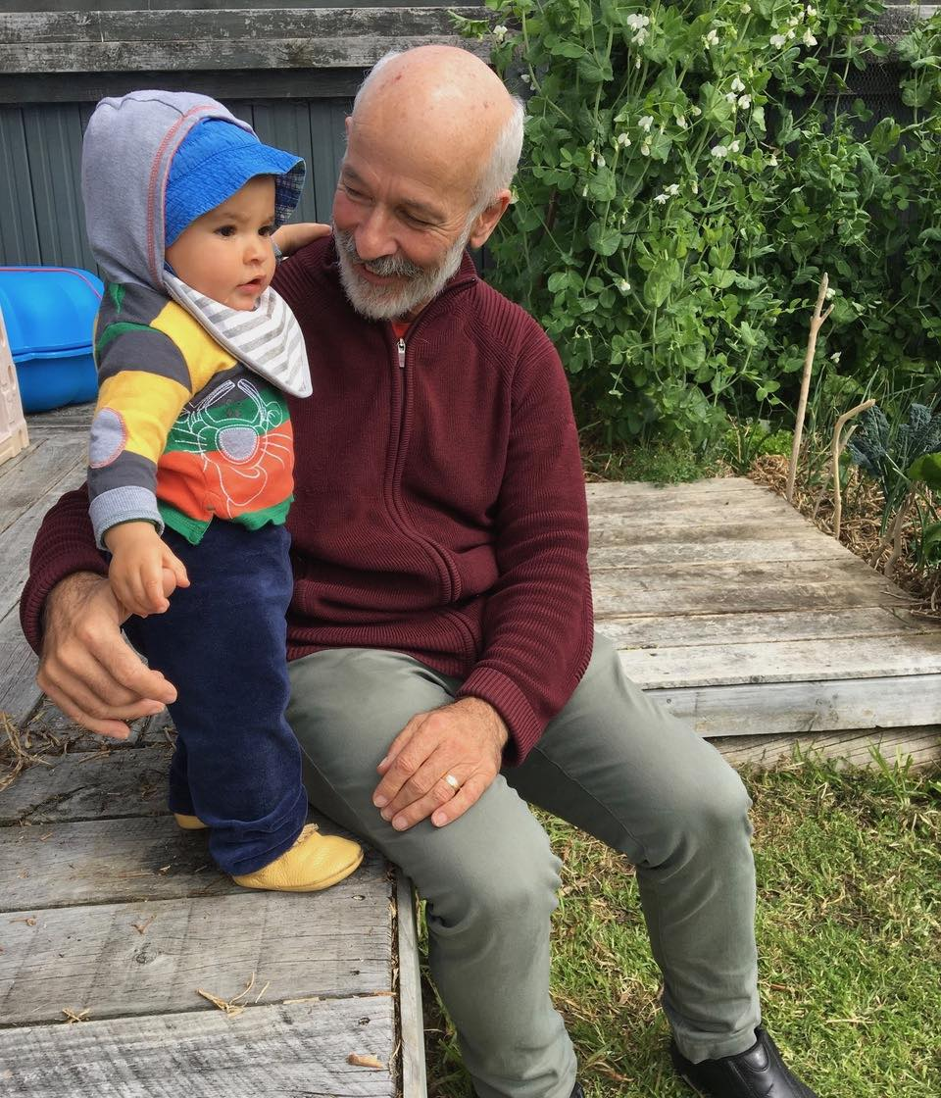
For the joy of human love Brother, sister, parent, child Friends on earth And friends above For a gentle Thoughts and mild For a gentle Thoughts and mild
Lord of all to thee we raise This our joyful hymn of praise

Slide 5
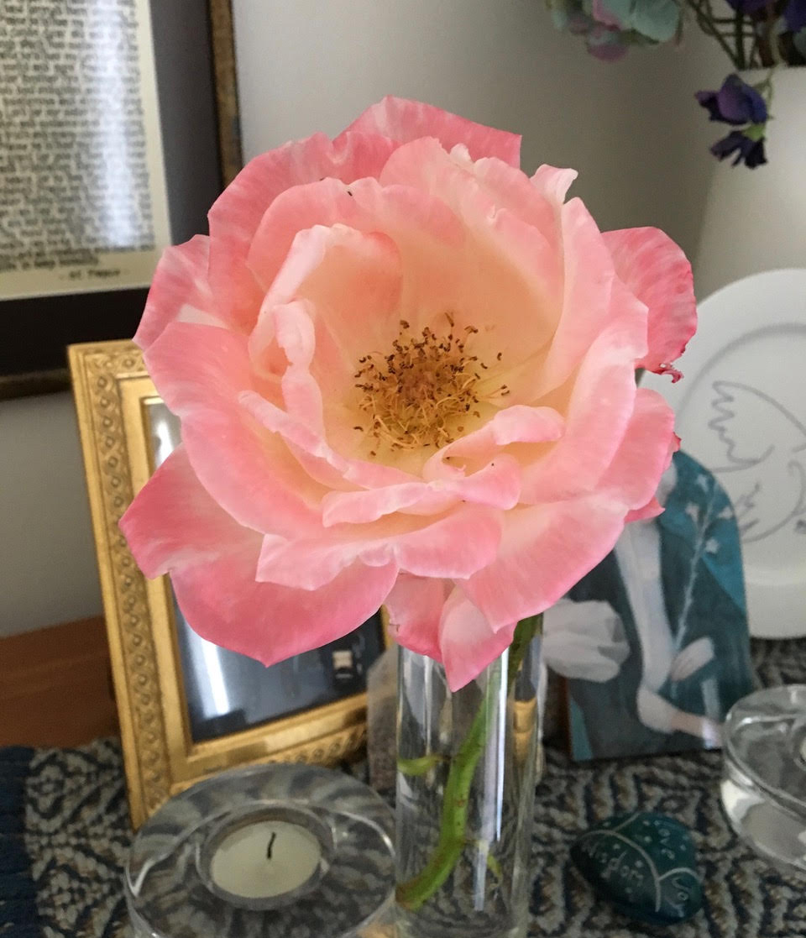
For each perfect gift of thine To our race so freely given Graces human and divine Flow'rs of earth and buds of heav'n Flow'rs of earth and buds of heav’n.
Lord of all to thee we raise This our joyful hymn,
our joyful hymn of praise This our joyful hymn of praise.

