Slide 1

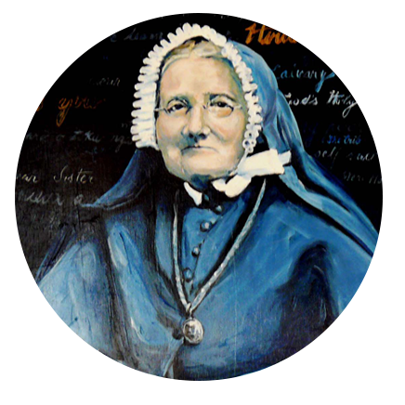

Prayer of the faithful
E te Atua o te Aroha me te Pūaroha – God of Love and Compassion
On this Celebration Sunday, we remember the life of
Suzanne Aubert Meri Hōhepa and the way she put tender kindness into action. We pray that her example of love-in-action, compassion in difficult times, generosity of spirit, advocacy for the poor and reliance on God’s love,
will continue to inspire the people of Aotearoa New Zealand.
E te Ariki: Whakarongo mai rā ki a mātou

